Slide 1
Ground Station and
Satellite Tracking System
A Western CubeSat Project
Notes:
Introduction of self and our project title

Slide 2

The Project
Notes:
Talk about cubesat project, Western has received a 200k grant to develop 2 microsatellites which will be used for LEO imagery of the earth. The project is doing concurrent designs with UHF and S-band communications which are two radio frequencies with different directional capabilities, blah blah blah.

Slide 3

Problem statement
Problem
Statement
To design and build a functional satellite tracking ground station
Westen’s CubeSat Project lacks an accessible ground system that can maintain communication with the satellite
Notes:
The problem statement is that the we need to design this fucntion satellite tracking ground station, motivation is that the western cubesat team needs one to complete their research as the GS will be the connection point between the cubesat in orbit and the mission control team on the ground.

Slide 4
Objectives
Transportable
Uses COTS components
Low maintenance
Can collapse
into itself
Easy to assemble/
disassemble
Minimal human interaction
Housekeeping sensors
Notes:
These things are nice to have and are things that we will strive to have in our final design however our project is not a failure if we dont manage these things

Slide 5
Constraints
Physical alignment
Orbital trajectory prediction
Correct antenna direction
Withstand external environment

Slide 6
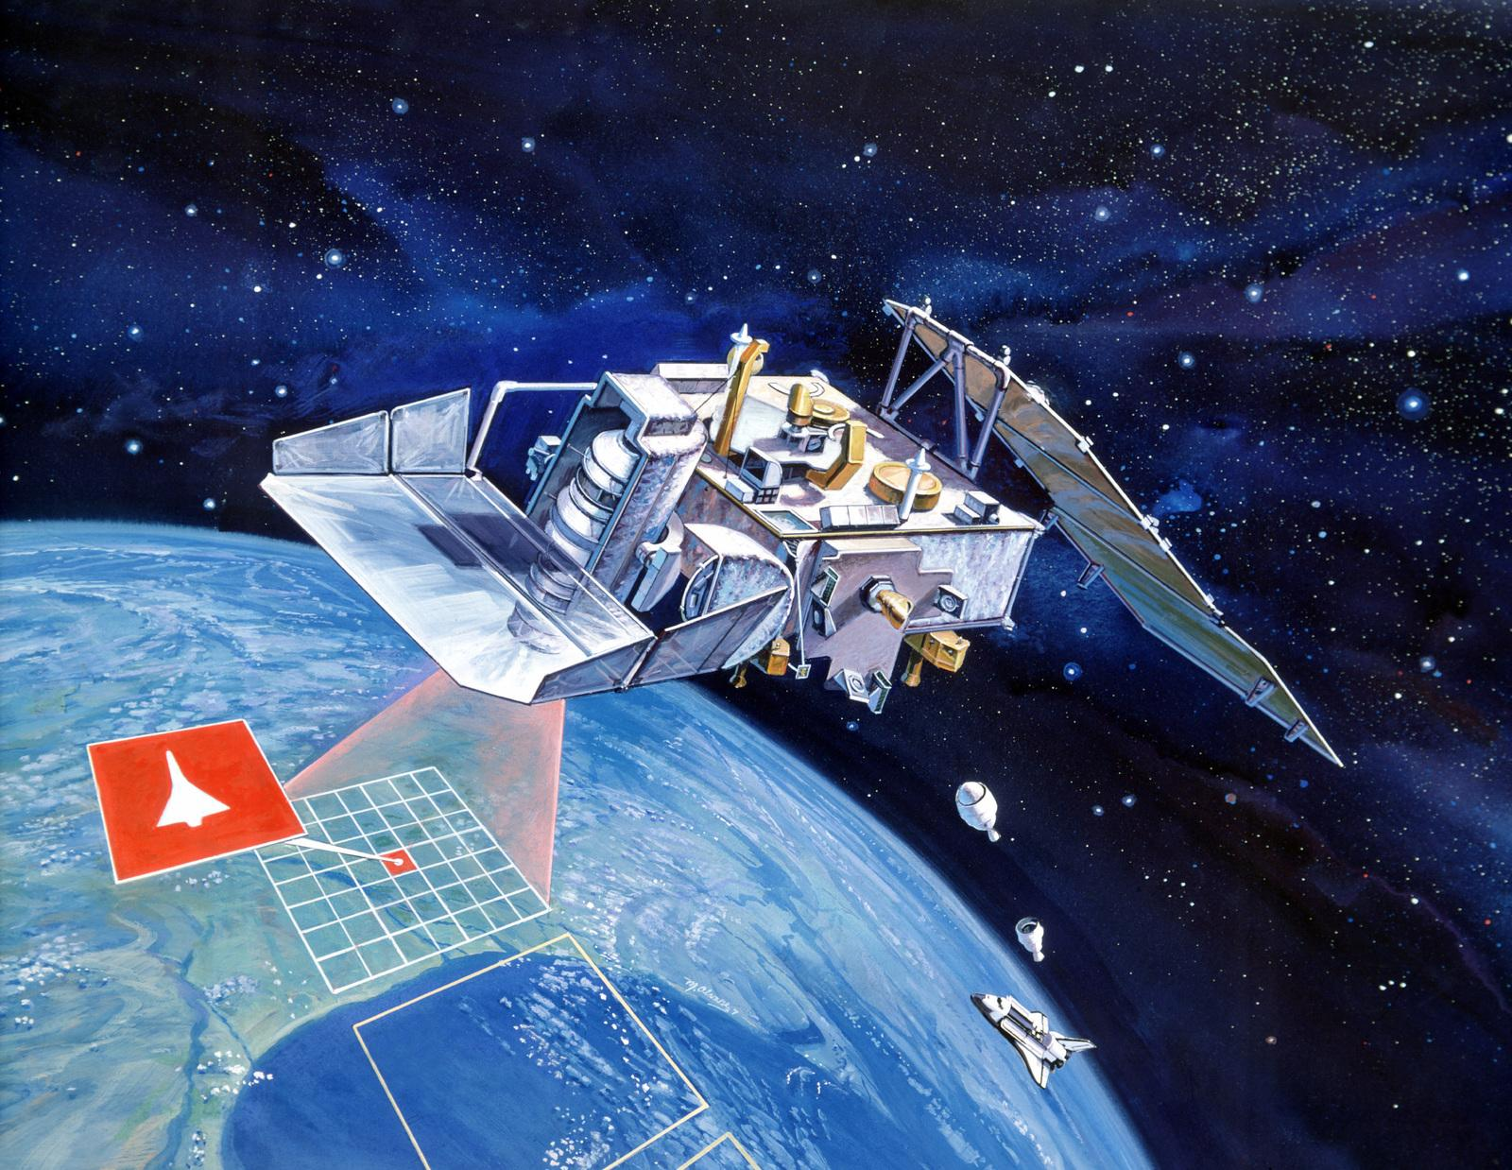
What customers do today
Project
Scope
Designing the physical ground station
Designing and implementing a satellite tracking algorithm Designing controller

Slide 7
Concepts
Three main physical design components
Base
Rigid. Stable. Transportable.
Actuation System
Lightweight. Accurate. Low Cost.
Antennae Placement
Balanced. Stable.

Slide 8
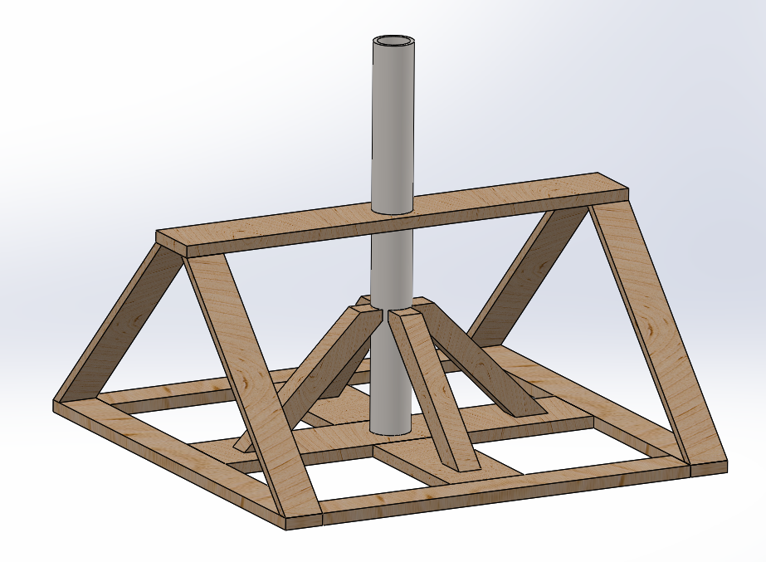
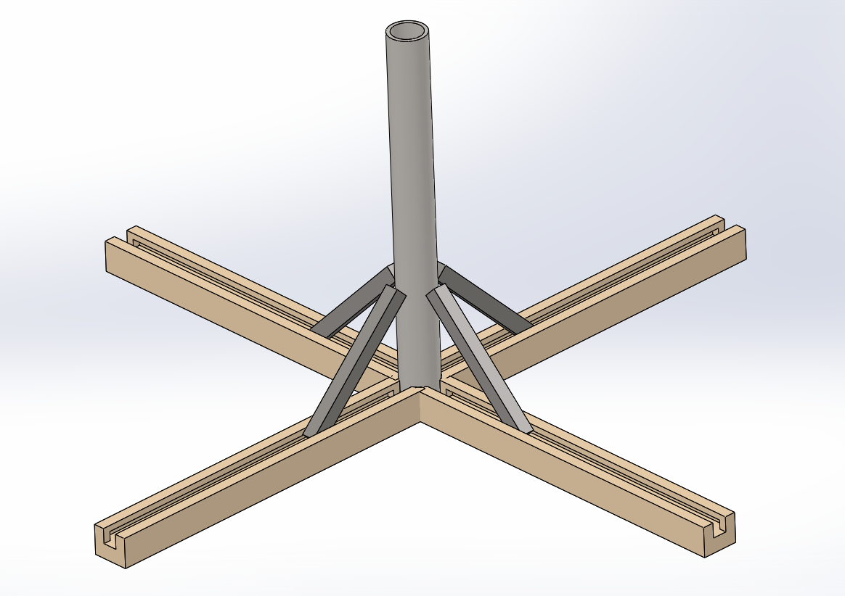
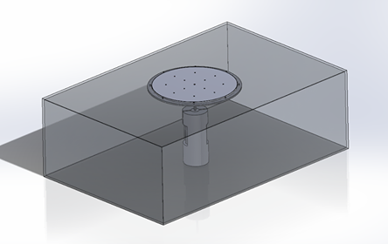
Base
56%
42.2%
53.9%

Slide 9
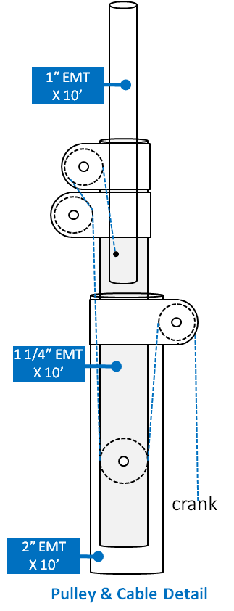
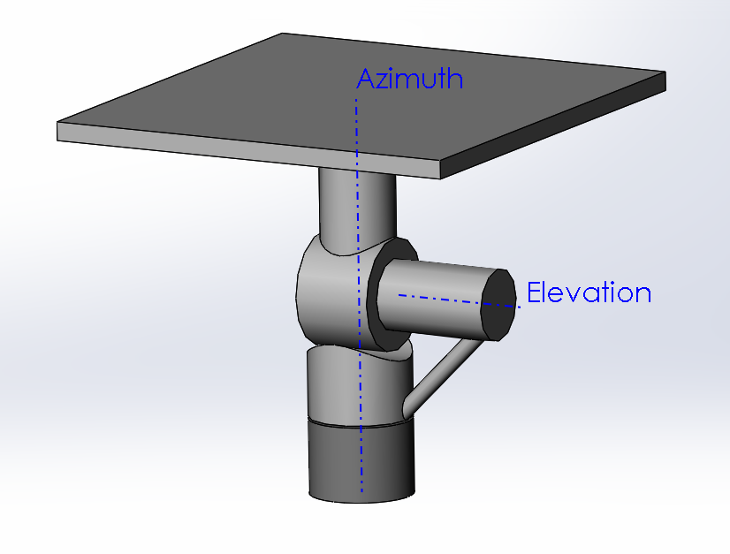
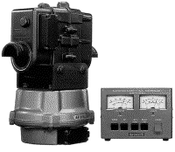
Actuation Systems
46.1%
44.5%
37.4%

Slide 10
Antennae Placement

Slide 11
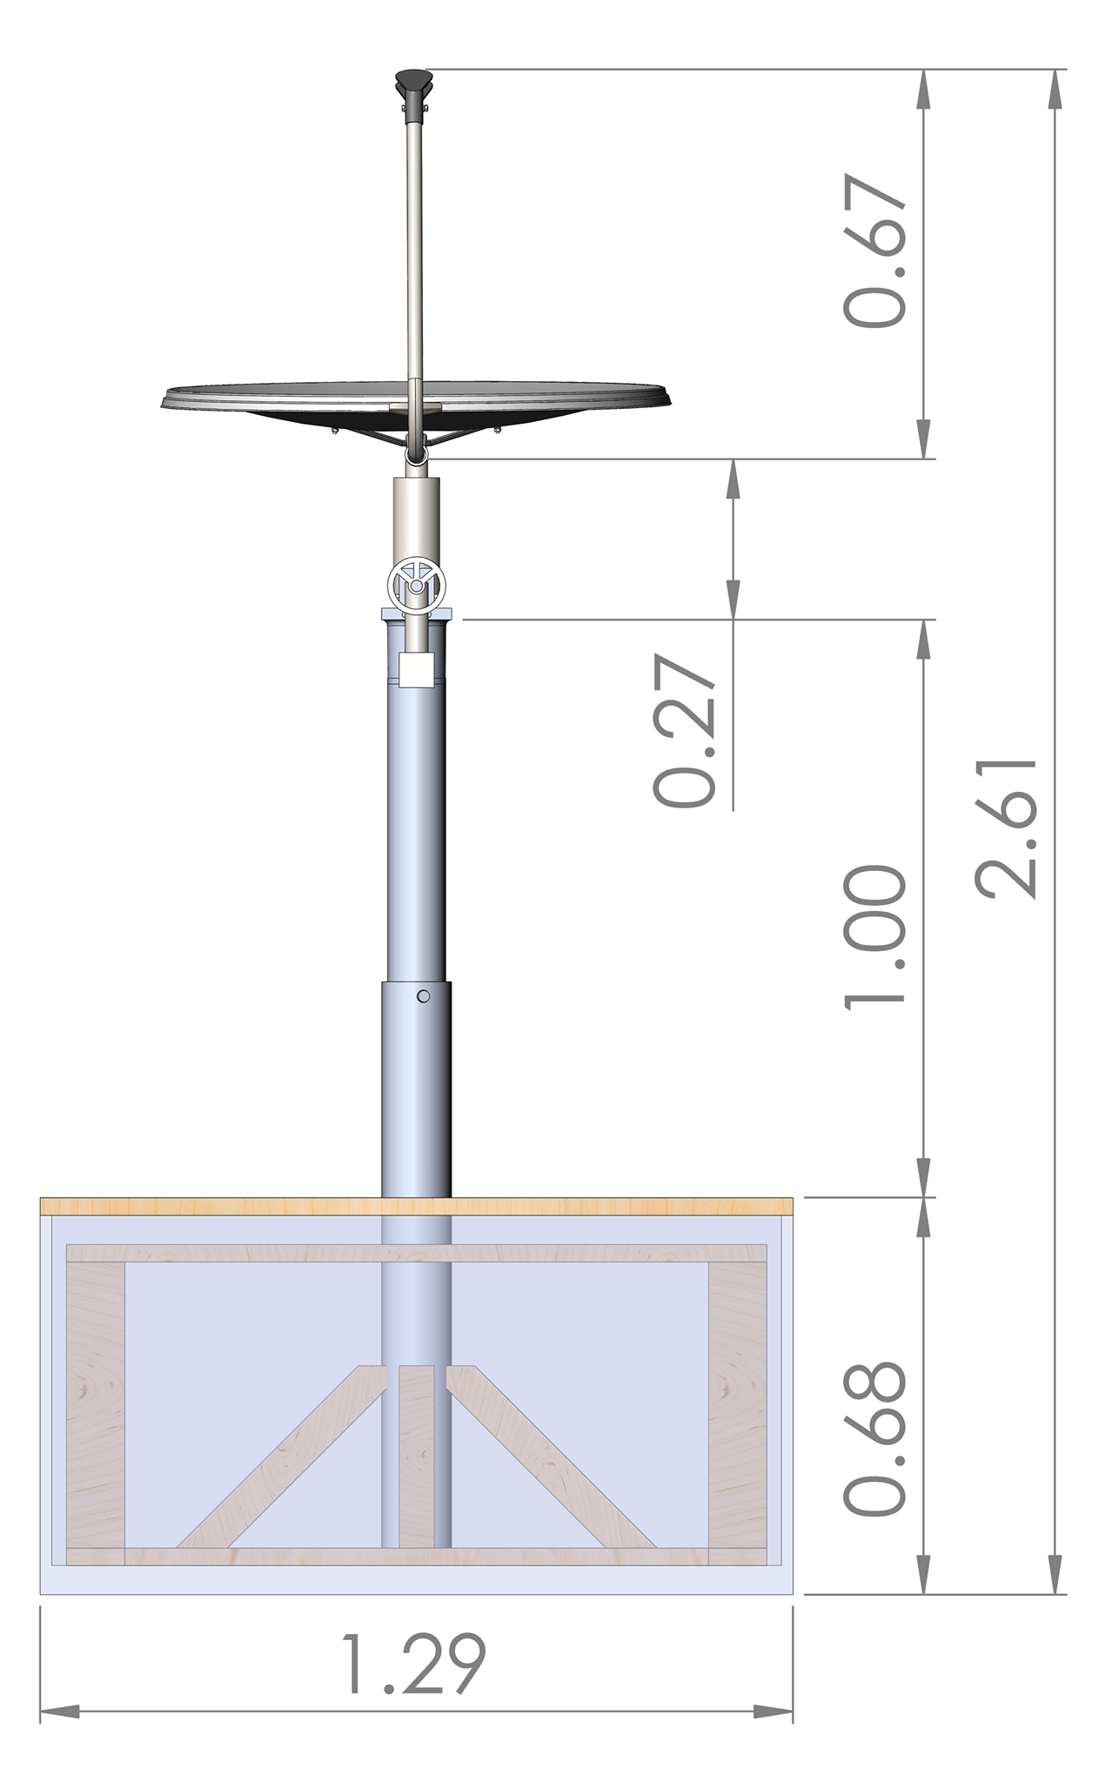
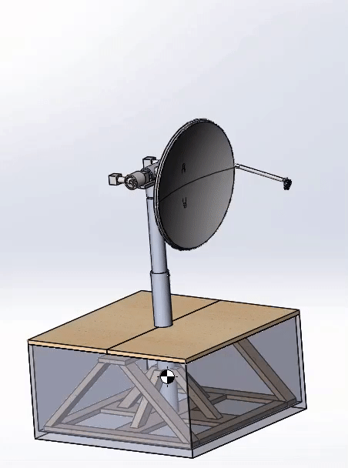
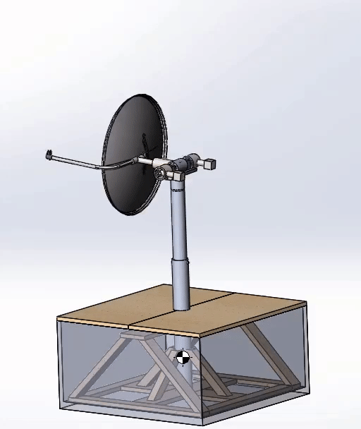

Slide 12
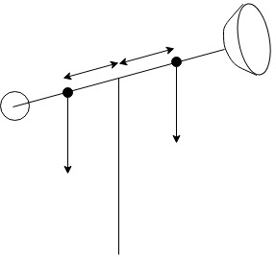
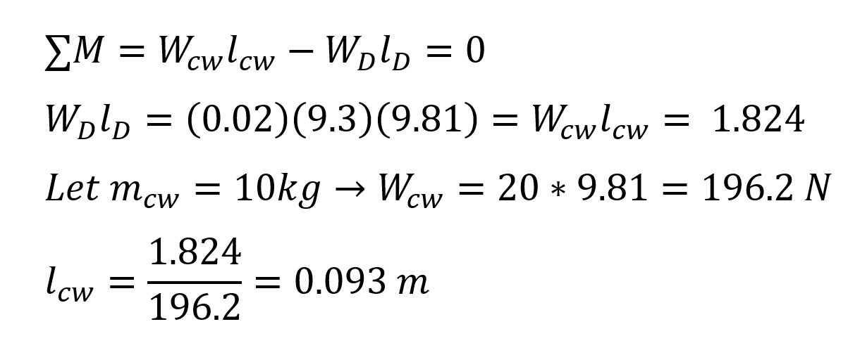
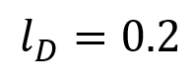
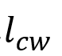
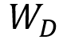

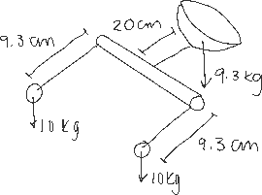
Design Analysis
Counterweight Analysis:

Slide 13
Design Analysis
Maximum Torque Needed

Slide 14
Design Analysis
Tipping Point Analysis:

Slide 15

Controls Scheme
Angular position will be modelled as motors using the transfer function:
$$\frac{Θ_{m}(s)}{E_{A}(s)}=\frac{\frac{k_{t}}{R_{A}J }}{s(s+\frac{D}{J}+\frac{k_{t}k_{b}}{R_{A}J})}=G(s)$$
And using PI control:
$C\left(s\right)=K_{p}+\frac{K_{I}}{s}=\frac{sK_{p}+K_{I}}{s}$
ϴ_d
+
ϴ_m
C(s)
G(s)

Slide 16
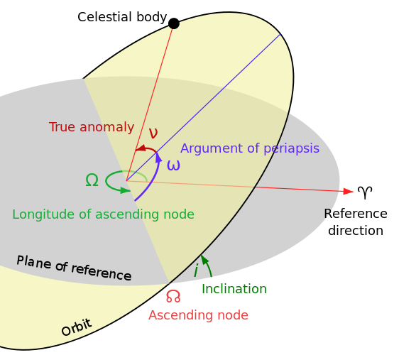
Software
Initial position
Communication with CubeSat
Wait for CubeSat
Time, satellite parameters
SGP4 or SGP8 prediction model
Get next overhead time and location
Set the angle of antennae
Notes:
flow

Slide 17
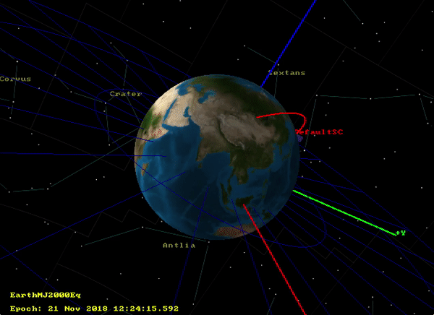
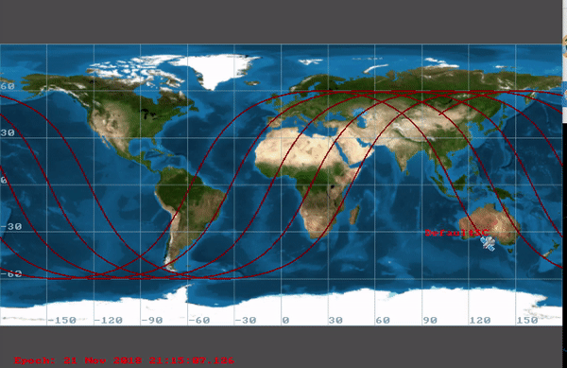
Notes:
simulation

Slide 18
What next?
Ordering and interfacing with hardware
Algorithm design and iterative testing
Fabrication of body
Troubleshooting designs

Slide 19
Timeline
OCT
NOV
TODAY
DEC
JAN
FEB
MAR/APRIL
Requirements gathering
Concept generation and selection
Preliminary design roast
Ordering hardware
Interfacing with hardware
Software development
Struggling
Systems integration
CRUNCH TIME
Testing and fine tuning

Slide 20
Questions?

Slide 21
References
Canadian CubeSat Project
Wind Velocity and Wind Loads
Wind Hazard Map

Slide 22
Appendix 1
Decision Matrix for Base:

Slide 23
Appendix 2
Evaluation Matrix for Base:

Slide 24
Appendix 3
Decision Matrix for Actuation System:

Slide 25
Appendix 4
Evaluation Matrix for Actuation System:

